Slide 1


Slide 2
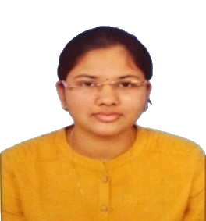
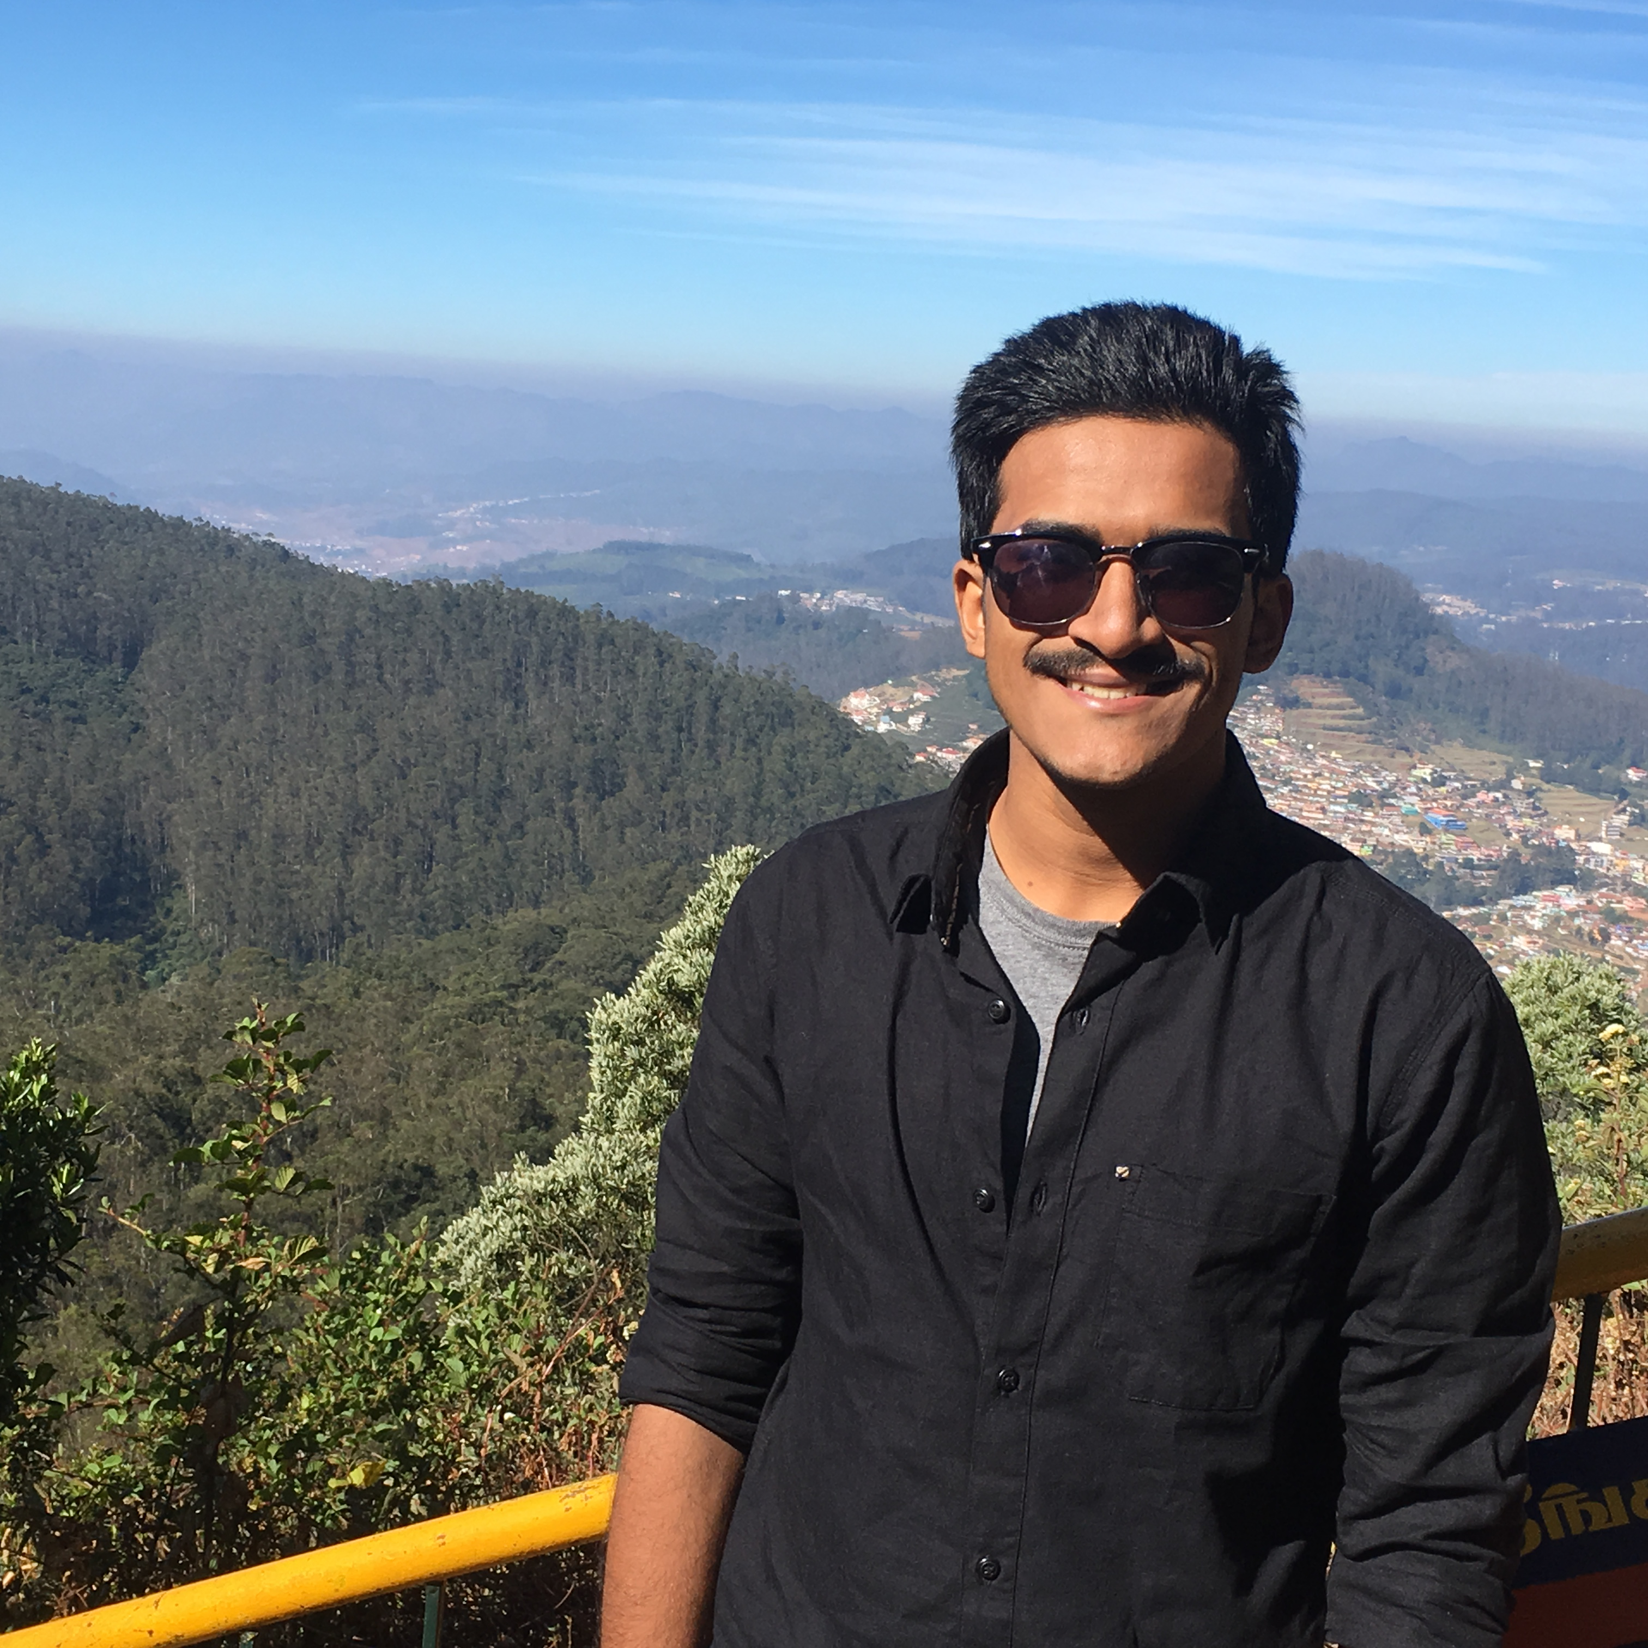
Project Highlights
Project Name : Pocket Signal Generator
Team Size : 2
BU Mentor Name : Kalpesh Patel
Anusha Avvaru
PS No. 99002667
ICP BU
2009BLRICP01
B.Tech(EEE)
Labeeb Ali Koleth
PS No. 99002617
ICP BU
B.Tech in Electronics and Biomedical Engineering

Slide 3
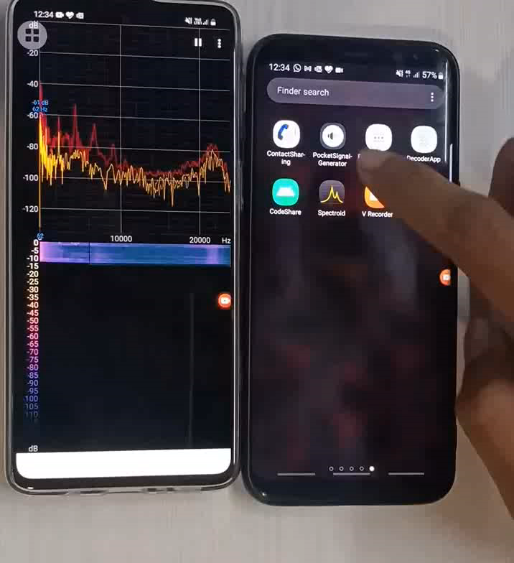
Project Video Snippet
Phase 1: Pocket Signal Generator

Slide 4
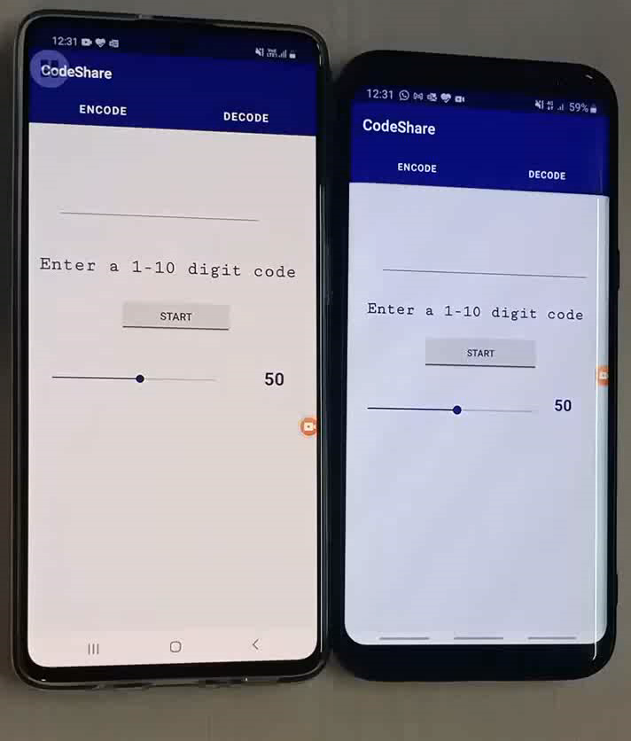
Project Video Snippet
Phase 2: Code Sharing

Slide 5
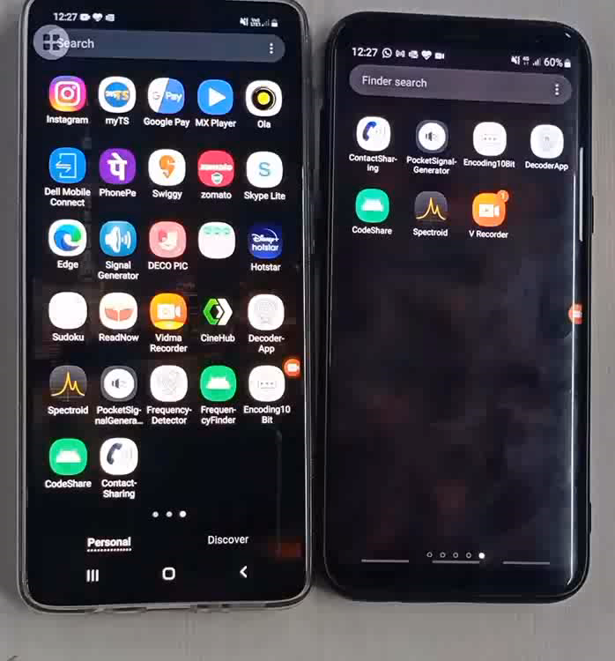
Project Video Snippet
Phase 3: Contact Sharing

Slide 6
Future development that can be implemented further
Extending to IOT Applications.
Access Contact list in the Mobile and add it directly to the application.
Plotting of stationary waveform on the screen.

Slide 7


Thank You !

